Slide 1
CS4499/5599: Data Science and Applied Machine Learning
Class Lecture: April 17th, 2023

Slide 2
Objectives
Last time:
Discussed the basics of unsupervised learning
Clustering using K-Means
Today:
Finish K-Means
DBSCAN Clustering
Image Segmentation with Unsupervised Learning
Dimensionality Reduction
Principal Component Analysis (if time permits)

Slide 3
Calculating Centroids
How do you we know which is the results is the best?
We can use a metric known as model inertia to evaluate our iterations
Inertia is simply the mean squared distance between each point and its closest centroid
We keep the results that have the lowest inertia
Sklearn does have a method to get the inertia (.inertia_) but be very wary of using .score with K-Means as it is possible to get a negative value

Slide 4
Optimal Number of Centroids
Another major consideration for a training a K-Means model is the number of clusters we will create
Our example showed 5 clear clusters, but it in application this will rarely be obvious
This may be the most important consideration, as a poor k number will likely result in a poor model
If we use too many clusters, we will cut-up good clusters into smaller clusters we don’t need
If we use to few clusters, our clusters will start merging into large less useful clusters

Slide 5
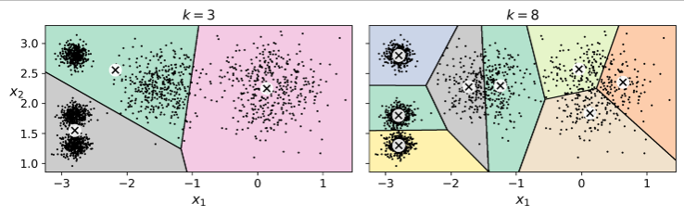
Optimal Number of Centroids
Consider these versions of our previous example
An easy trap to fall into is to only consider the inertia value for our data, however this is not always the case (the inertial value for k=8 is 119.1 vs 211.6 for our example)

Slide 6
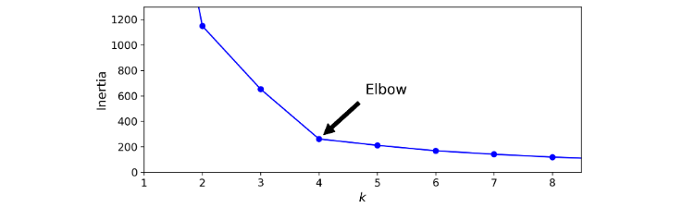
Optimal Number of Centroids
In fact, as the number of clusters increases the inertia decreases
You will notice that at k=4 we have a major inflection point for our inertia values, after 4 the improvement in inertia is minimal

Slide 7
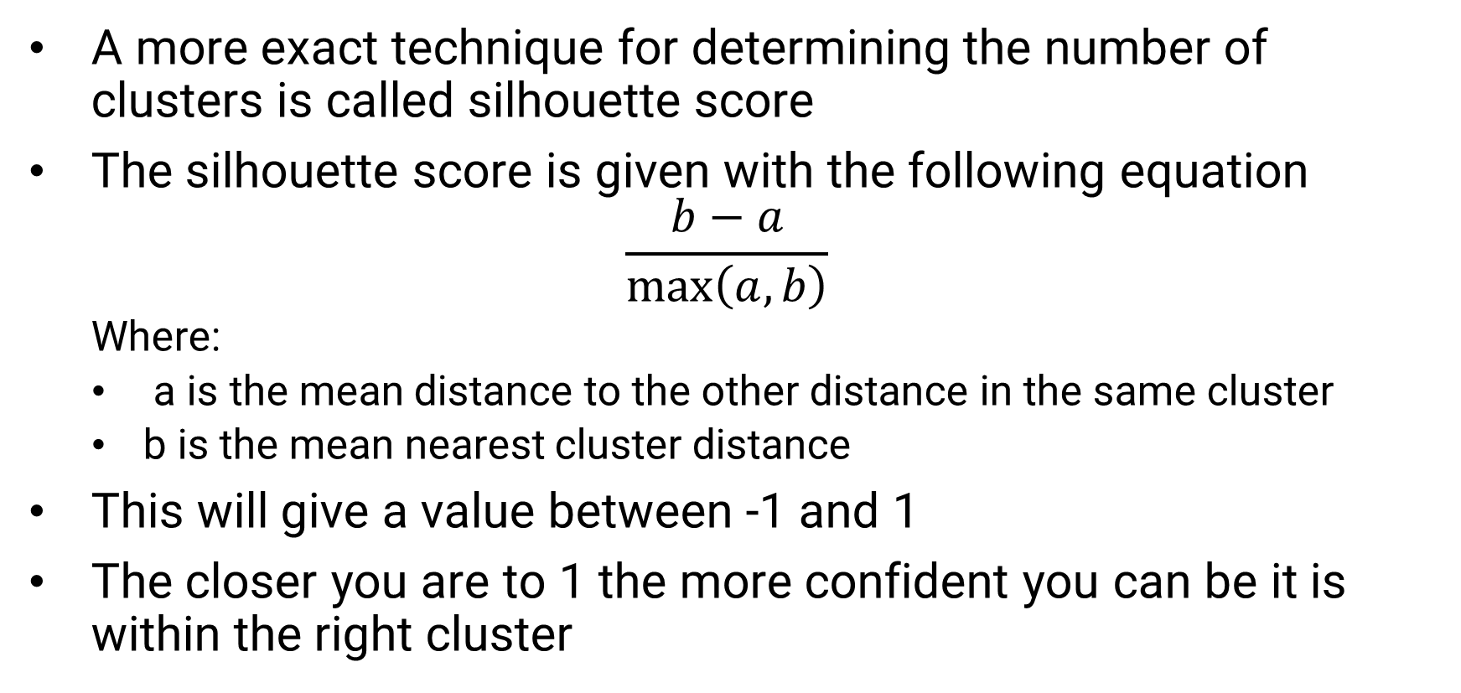
Silhouette Score
A more exact technique for determining the number of clusters is called silhouette score
The silhouette score is given with the following equation
$$\frac{b−a}{\max\left(a,b\right)}$$
Where:
a is the mean distance to the other distance in the same cluster
b is the mean nearest cluster distance
This will give a value between -1 and 1
The closer you are to 1 the more confident you can be it is within the right cluster

Slide 8
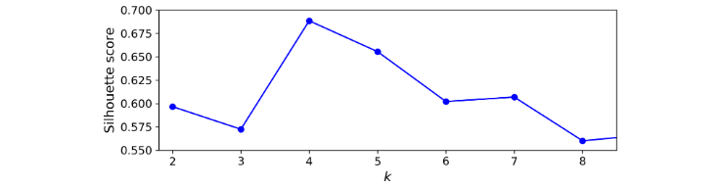
Silhouette Score
Let’s look at the silhouette score for our blobs example:
From this you can tell both 4 and 5 are excellent choices for your k value
Sklearn has a function for silhouette score sklearn.metrics. silhoutte_score

Slide 9
Pros and Cons of K-Means
K-Means is a popular choice in the area of unsupervised learning because:
Fast
Scalable
However, there are a number of issues with the approach that should be considered:
It is a very iterative process (finding the right centroid, finding the optimal k, etc.)
K-Means does not like clusters that vary significantly in size, shape, or density

Slide 10
Improving K-Means
There have been several improvements that have been introduced to improve the process of calculating centroids:
K-Means++, which seeks to ensure centroids are further away from each other
The first centroid is placed at random, and probabilities are used to ensure the next centroid is a distance D(x^{j}) away from the first
Accelerated K-Means, which looks to reduce computation time by reducing the number of distance calculations needed
Sklearn uses both of this improvements by defaults

Slide 11
Mini-Batch K-Means
Mini-batch K-Means will use small subsets of the dataset rather than the entire dataset for each iteration
This can speed up the algorithm by a lot and can allows for the use of very large datasets that would not fit into memory otherwise
However, the inertia tends to be higher with these types of models, especially as k increases
Sklearn has a class for mini-batch K-Means: sklearn.cluster.MiniBatchKMeans

Slide 12
DBSCAN Clustering
As we discussed last time, clustering is a very vague term and different methods define a cluster differently
The DBSCAN clustering method uses continuous regions of high density as clusters
DBSCAN counts how many instances are located within a distance (ε), this is known as the instances ε-neighborhood
If an instance has least min_instances (a user specified value), then the instance is considered a core instance
All instances within a neighborhood of a core instance belong to the same class

Slide 13
DBSCAN Clustering
It is important to note, that a neighborhood may include other core instances, so a long sequence of neighboring cores will form a single cluster
Any instance that is not a core instance and does not have one in its neighborhood is consider an anomaly
Anomalies are labeled as a -1 by the sklearn DBSCN class
DBSCAN works best when the cluster are dense and if they are well separated
Unlike K-Means this approach is very robust to outliers and can handle clusters of any shape

Slide 14
DBSCAN Clustering
The sklearn class for DBSCAN doesn’t use a predict function, instead it uses fit_predict() function
This means rather than predict which cluster a new instance belongs to, we implement this method with a different approach ( we will do an example of this)
DBSCAN is typically very fast, most time you will have run at O(n), the worst case is O(n²) (especially if your ε is high)
Note that if your clusters are not very dense or the density varies across the data, the models produced will likely be of poor quality

Slide 15
Other Forms of Unsupervised Learning
A few other popular unsupervised learning techniques include:
Gaussian Mixtures
Fast Minimum Covariance Determinate (Fast-MCD)
Isolation Forest
Local Outlier Factor (LOF)
One Class SVM

Slide 16
Image Segmentation
Another common application of unsupervised learning is image segmentation
The goal of image segmentation is to divide up our image into segments, we can go a step further and use sematic segmentation to divide up object types into specific segments
Today most image segmentation is done by Convolutional Neural Networks (CNNs), but this is a good intro
For right now we will focus on color segmentation

Slide 17
Dimensionality Reduction
You probably noticed with the image example, data can contain a great number of features
As our problems get more complex our data will have a greater chance of suffering from the “curse of dimensionality”
Too many features makes our models slower to train and can hurt model performance
In many cases we can remove certain features or combine only important components of feature to improve our model’s performance
Many of the techniques used for feature reduction are forms of unsupervised learning

Slide 18
Dimensionality Reduction
Dimensionality Reduction can be broken down into 2 approaches:
Projection
Manifold Learning

Slide 19
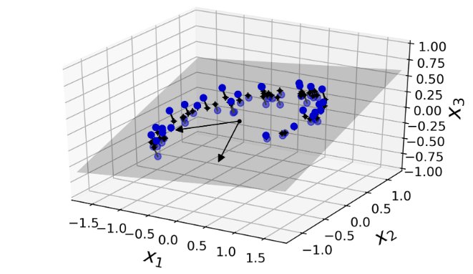
Projection
In most real word problems, instance are not spread out uniformly, most instances lie within a lower subspace
Consider this example from Geron:

Slide 20
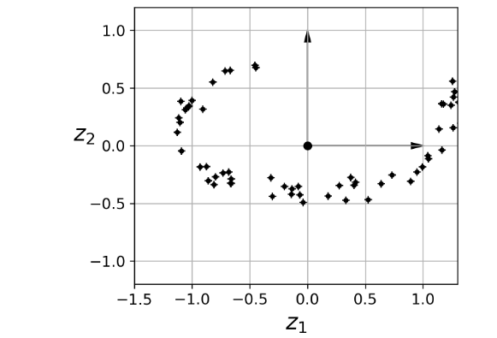
Projection
You can clearly see that in that example there is very little variation along that x3 axis
We can project all those instances perpendicularly into a 2D plane

Slide 21
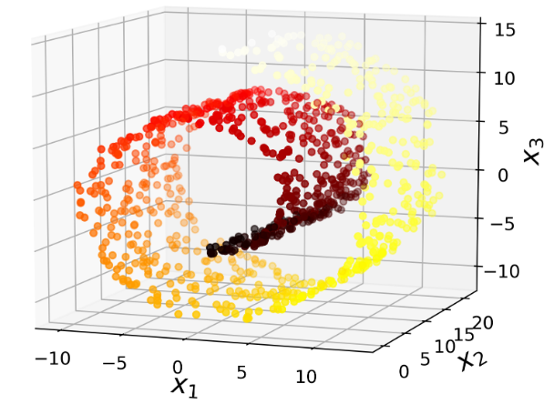
Manifold Learning
Projection isn’t always the best case, take this Swiss role data:
If we project this data into a 2D plane, it is going to compress those layers together
What we want to do is “unroll” this data into 2D space

Slide 22
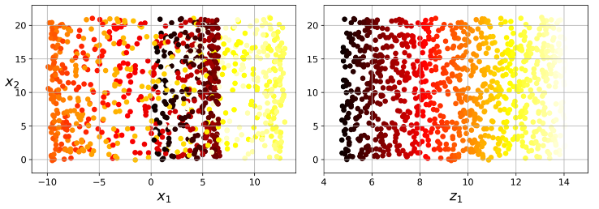
Manifold Learning
A manifold is a shape that we can bend and twist into a higher dimension space (the Swiss roll is a 2D manifold)
Many dimensionality reduction techniques work by modeling manifolds

Slide 23
Manifold Learning
Its important to note this is not a “one size fits all” approach
Manifold learning relies upon the assumption that real high dimension data lie close to a lower dimension manifold, this is known as the Manifold Hypothesis
As always this depends on your data
Now we will look at two algorithms for dimensionality reduction:
Principal Component Analysis (PCA)
t-distributed stochastic neighbor embedding (t-SNE)

Slide 24
MNIST Dataset
Before we discuss PCA, we should discuss the dataset we will be working with
The MNIST dataset like the Iris dataset is one of the most famous datasets in the field
The Modified National Institute of Standards and Technology (MNIST) dataset is a collection of 70,000 images of the numbers 0 through 9
Many machine learning researcher use this dataset as a testing set for their models
If you plan to continue on to neural networks, you will work with this set a lot

Slide 25
PCA
PCA is one of the most popular approaches for dimensionality reduction
It is a Linear Algebra based technique where we:
Identify the hyperplane that lies closest to the data
Then project the data on to that hyperplane
To find the optimal hyperplane we focus on preserving the max variance
The goal is to project on the hyperplane that has the most variance, so we lose the least amount of information

Slide 26
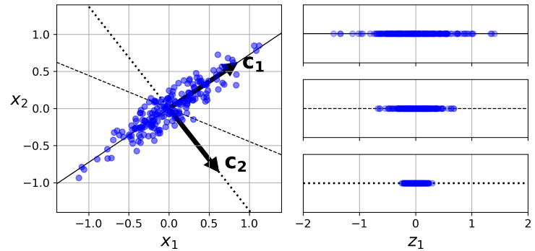
PCA
PCA identifies the axis that account for the largest amount of variance as well as an axis orthogonal to that axis (the one that account for the most remaining variance)

Slide 27
PCA
PCA will find as many orthogonal axis as there are dimensions in the dataset
Theses axes are referred to as principal components and can be found with a matrix factorization technique called Singular Value Decomposition (SVD)
Sklearn makes use of Numpy’s SVD function for its PCA class
Once we have all the principal components, we can reduce the number dimensions by projecting onto the hyperplane
The explained_variance_ratio method can be used to show the variances of each principal component

Slide 28
Reducing Dimensions
Now a major question that we need to address is how many dimensions should we reduce our dataset by?
If you want to visualize your data, you will most likely reduce to 2 or 3
Rather than arbitrarily reducing dimensions you want to select a number that will keep a significant amount of variance (in academics that is usually 95%)
We can specify the amount of variance using the n_components hyperparameter in the PCA class

Slide 29
Next Time
Finish Dimensionality Reduction:
t-SNE
Local Linear Embedding (LLE)
Hyperparameter Tunning and Gradient Descent
The undergraduate final project will be due on 5/3 by 5:00 PM
Graduate Presentations will be on 5/1 from 5:30-7:30 PM

